Slide 1
Beowulf Epic vs. Movie
Michael Center, Olivia Tenney, Briana Whitney,
Megan Gaschen, Amanda Beck

Slide 2
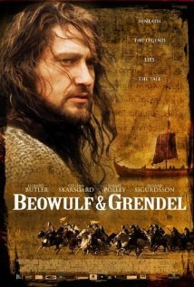
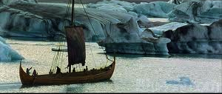
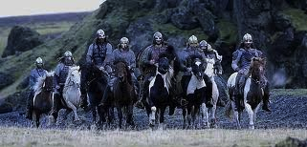
Movie: Beowulf vs. Grendel

Slide 3
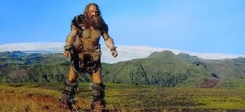
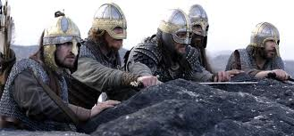
Pros of Beowulf vs. Grendel
Historically accurate
Allows you to visualize ancient Europe
Characters represented well
Beowulf shown as excellent swordsman
Grendel was man-like
Grendel is very smart and clever

Slide 4
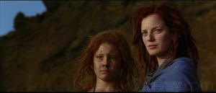
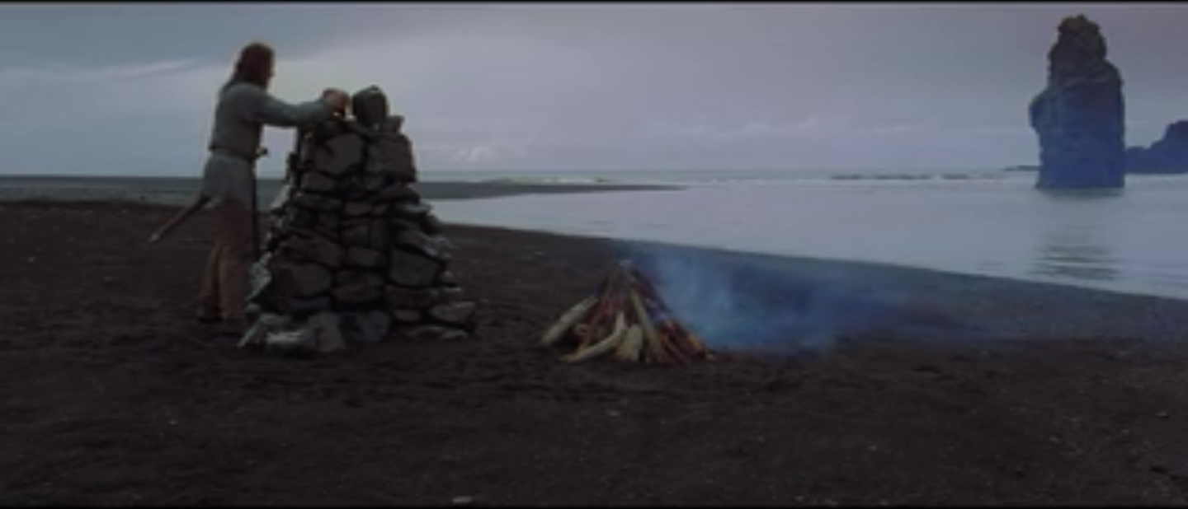
Cons of Beowulf vs. Grendel
New Characters
Did not follow tradition storyline
Grendel had child
Unnecessary love story
In modern movies, sexual tension is always added
Hrothgar portrayed poorly
Un-engaging beginning to movie
Grendel’s death not celebrated

Slide 5
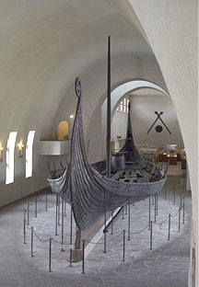
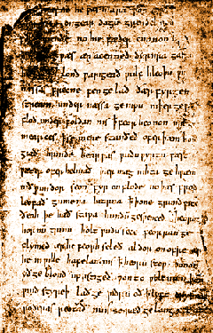
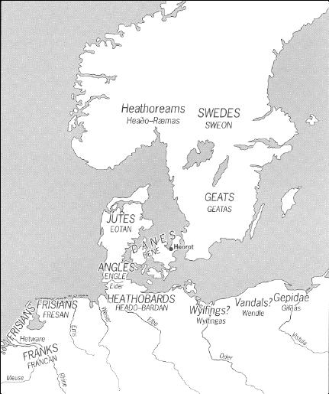
Epic Poem

Slide 6
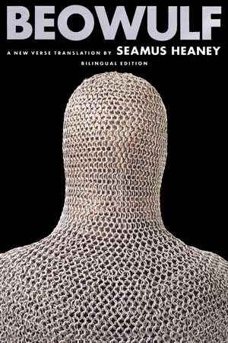
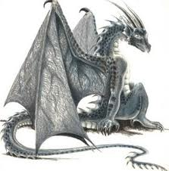
Pros of Epic
Exemplifies Beowulf as perfect Hero and warrior
Hrothgar is a great King
Rewarded treasure for help
Very descriptive of characters, scenes, and battles

Slide 7
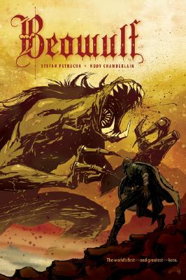
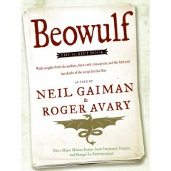
Cons of Epic
Very straightforward and predictable
Skips 50 years
Beowulf seems too super human
Difficult to read in original language

Slide 8
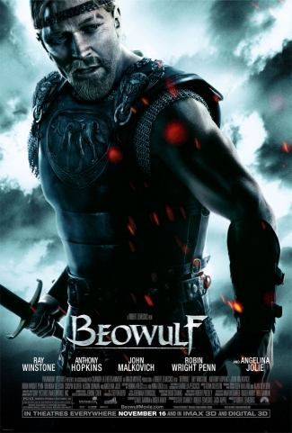
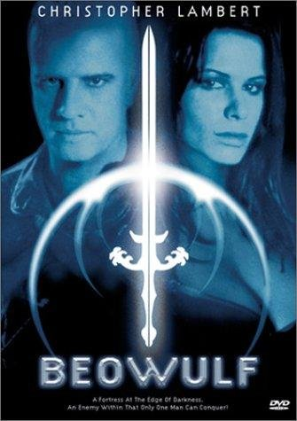
Other Beowulf Movies
None Follow traditional storyline….
Beowulf and Grendel’s Mother?
Placed in the future?

